Slide 1
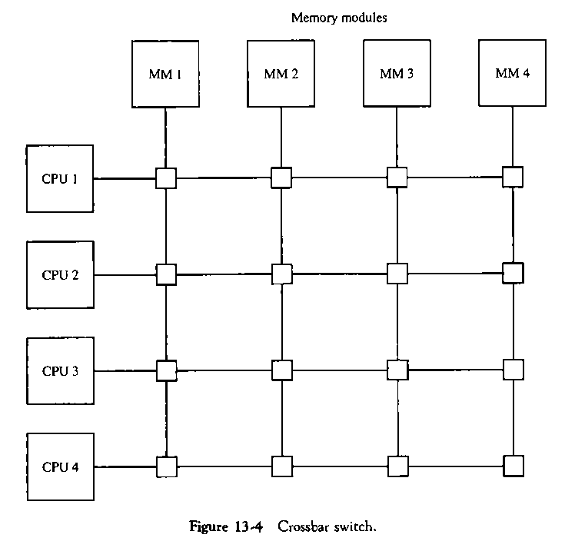
Crossbar Switch
The crossbar switch organization consists of a number of cross points that are placed at intersections between processor buses and memory module paths.
A switch that determines the path from a processor to a memory module.
Each switch point has control logic to set up the transfer path between a processor and memory.
Based on M. Morris Mano “Computer System Architecture”--Assist. Lecturer Ahmed Salah Hameed

Slide 2
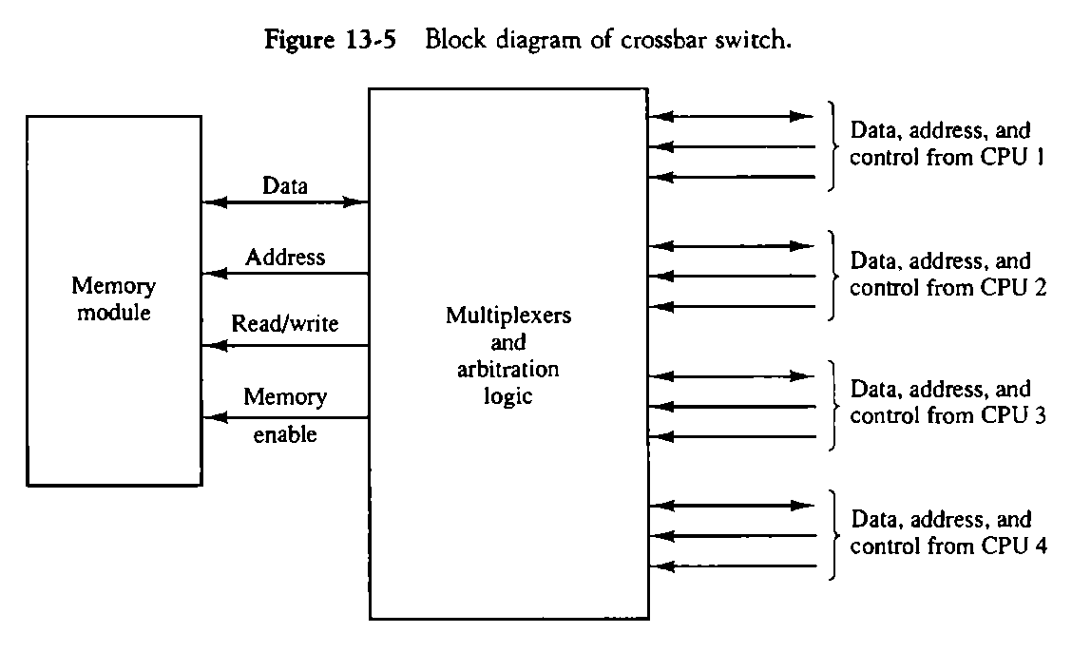
Crossbar Switch
Crossbar switch-control logic
It examines the address that is placed in the bus to determine whether its particular module is being addressed.
It resolves multiple requests for access to the same memory module on a predetermined priority basis.
Priority levels are established by the arbitration logic to select one CI when two or more CPUs attempt to access the same memory.
Based on M. Morris Mano “Computer System Architecture”--Assist. Lecturer Ahmed Salah Hameed

Slide 3
Crossbar Switch
Advantage
A crossbar switch organization supports simultaneous transfers from memory modules because there is a separate path associated with each module.
Disadvantage
The hardware required to implement the switch can become quite large and complex.
Based on M. Morris Mano “Computer System Architecture”--Assist. Lecturer Ahmed Salah Hameed

Slide 4
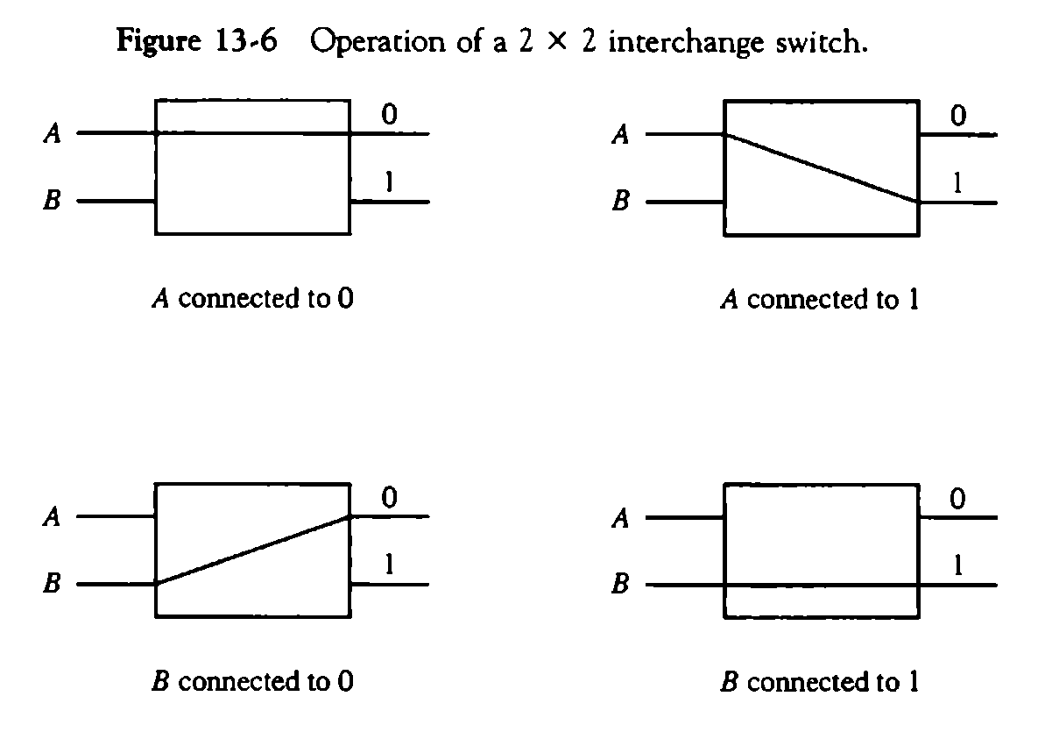
Multistage Switching Network
The basic component of a multistage network is a two-input, two-output
interchange switch.
Based on M. Morris Mano “Computer System Architecture”--Assist. Lecturer Ahmed Salah Hameed

Slide 5
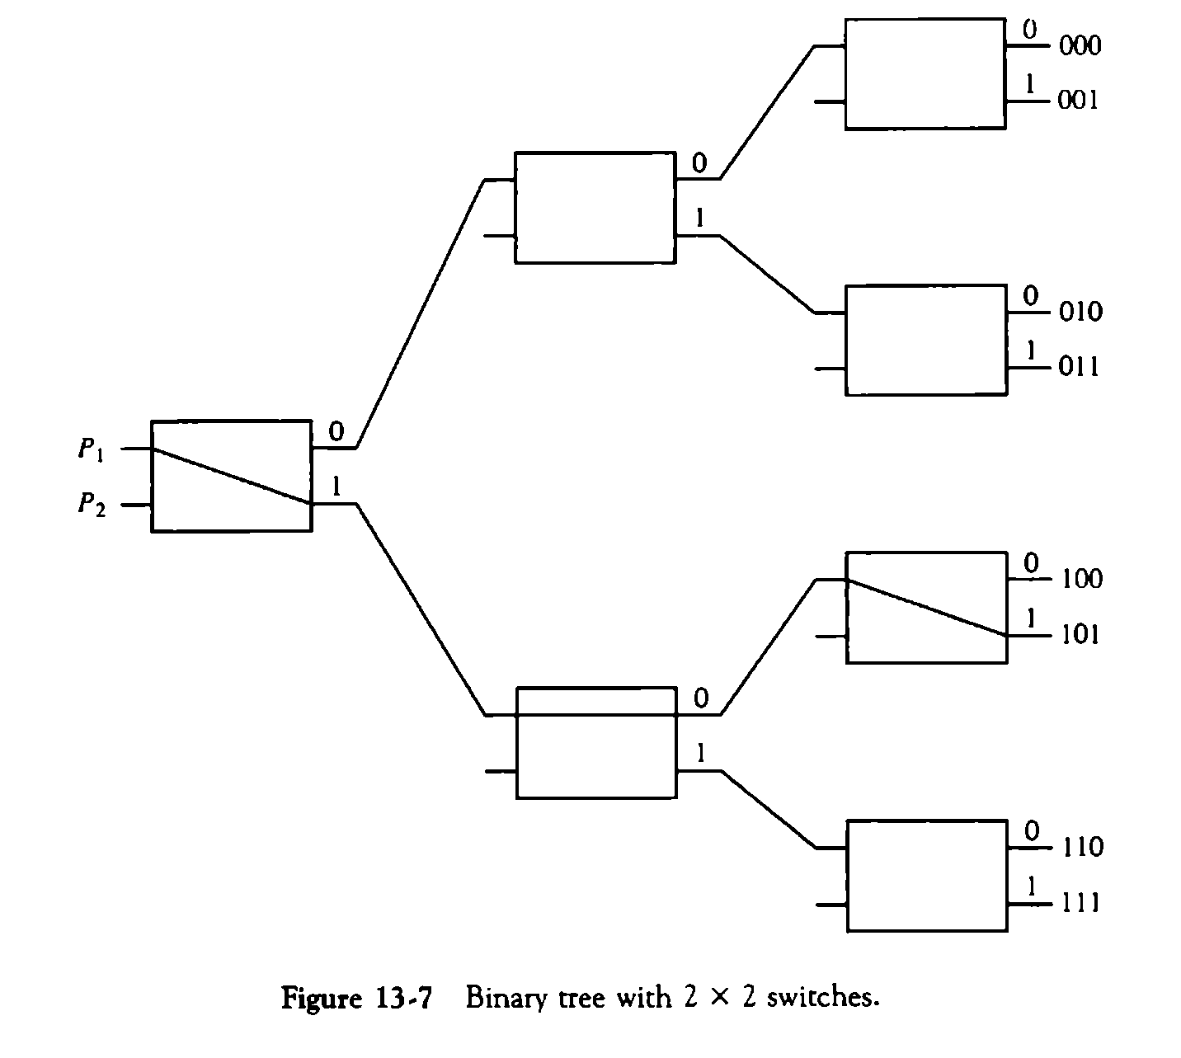
Multistage Switching Network-The binary tree
Based on M. Morris Mano “Computer System Architecture”--Assist. Lecturer Ahmed Salah Hameed

Slide 6
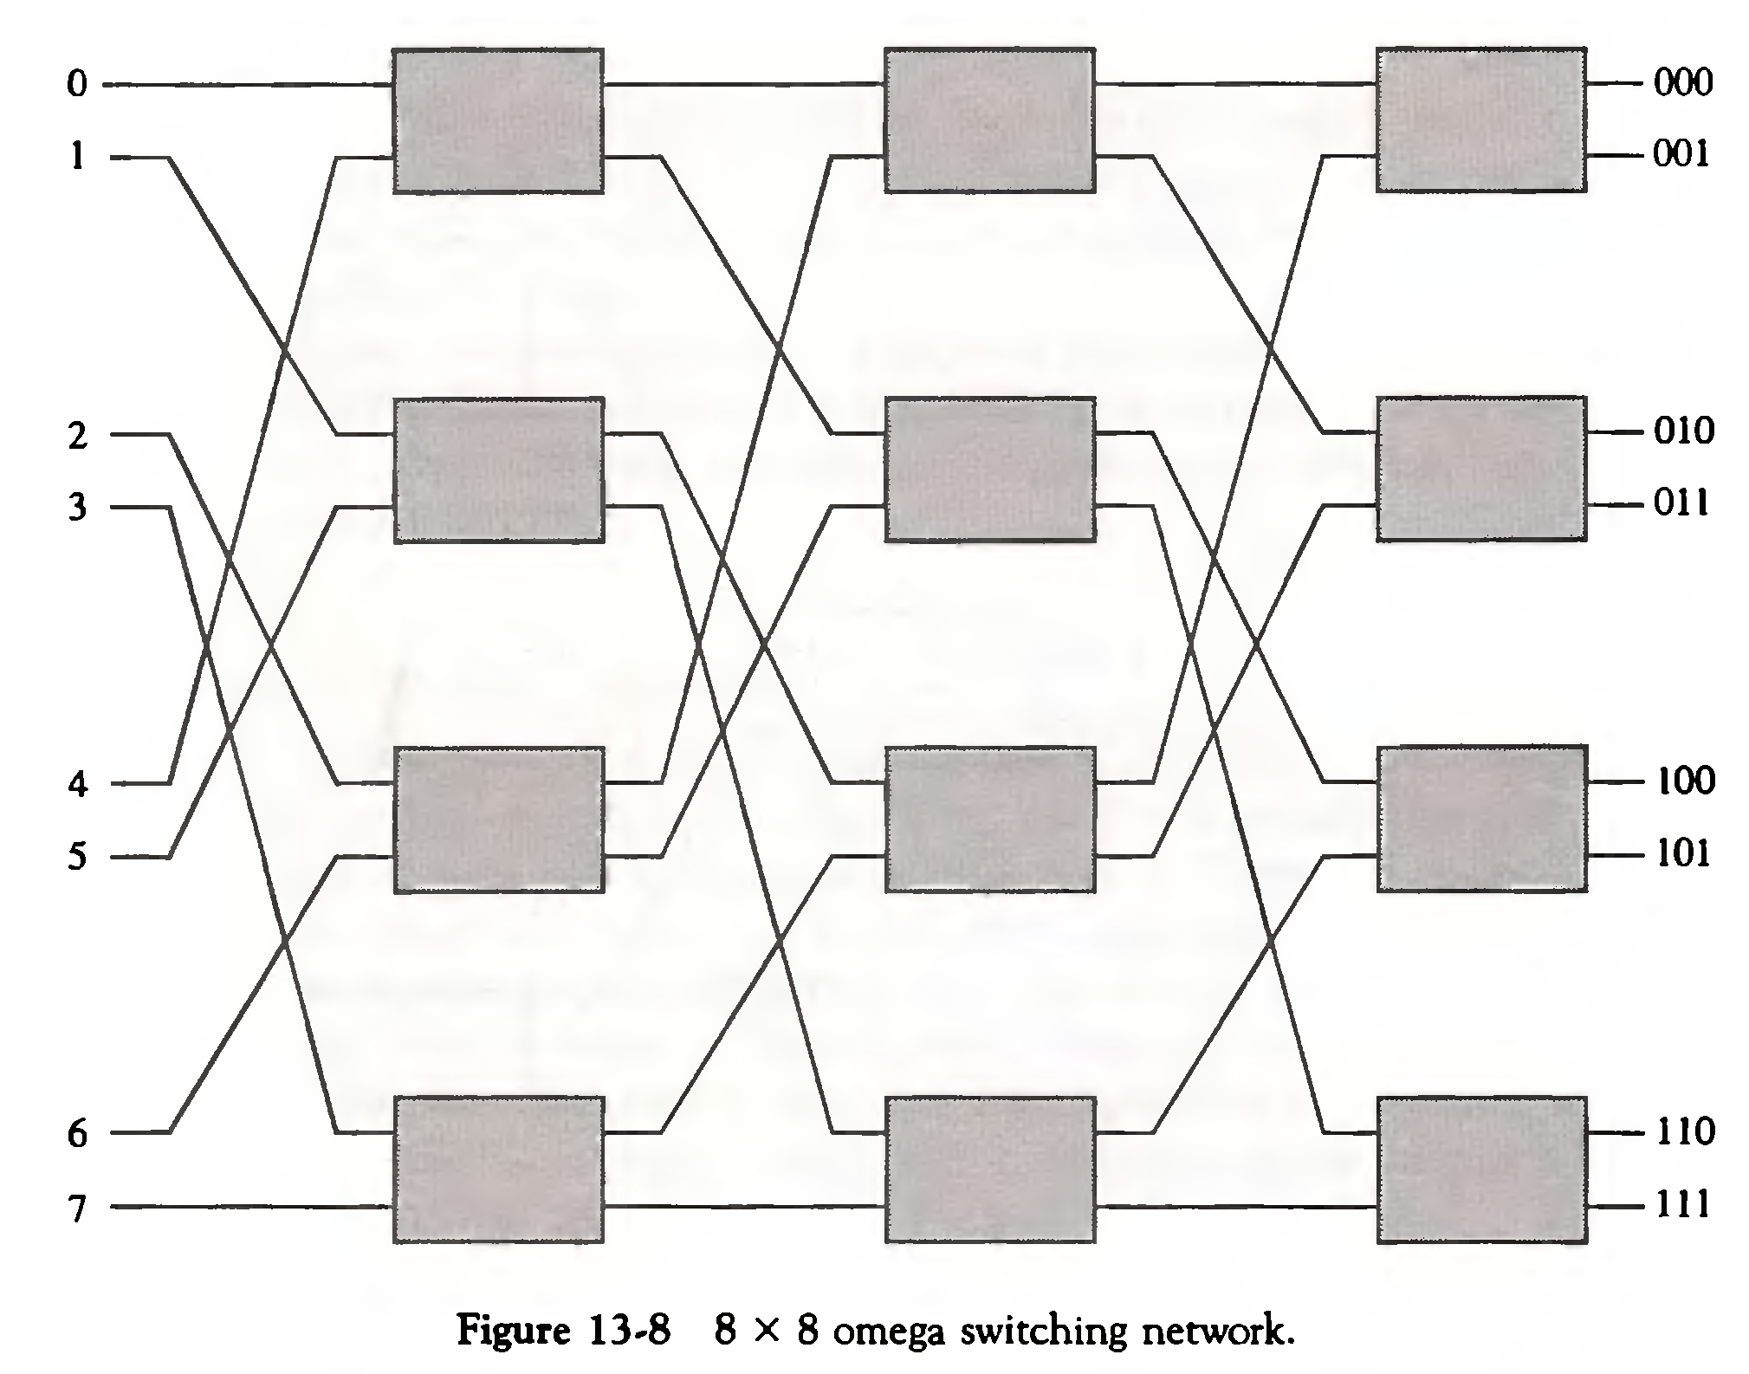
Multistage Switching Network-Omega network
Based on M. Morris Mano “Computer System Architecture”--Assist. Lecturer Ahmed Salah Hameed

Slide 7
Hypercube Interconnection
Also called binary n-cubes.
It is a loosely coupled system composed of N = 2^{n} processors interconnected in an n -dimensional binary cube.
Each processor forms a node of the cube.
Each processor has direct communication paths to n other neighbor processors.
These paths correspond to the edges of the cube. There are 2^{n} distinct n-bit binary addresses that can be assigned to the processors.
Each processor address differs from that of each of its n neighbors by exactly one bit position.
Based on M. Morris Mano “Computer System Architecture”--Assist. Lecturer Ahmed Salah Hameed

Slide 8
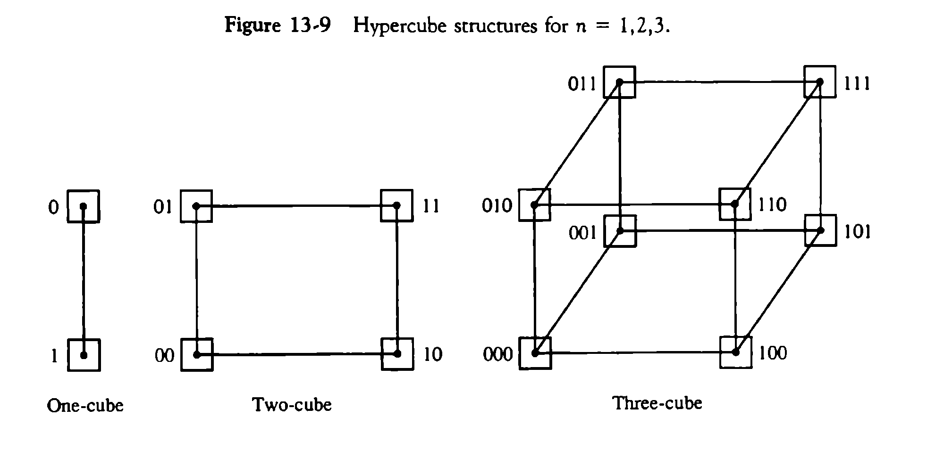
Hypercube Interconnection Labeling
Each node is assigned a binary address in such a way that the addresses of two neighbors differ in exactly one bit position.
Four-cube and five-cube?
Based on M. Morris Mano “Computer System Architecture”--Assist. Lecturer Ahmed Salah Hameed

Slide 9
Hypercube Routing
With a three-cube structure, node 000 can communicate directly with node 001.
Node 000 must cross at least two links to communicate with 011 (from 000 to 001 to 011 or from 000 to 010 to 011).
It is necessary to go through at least three links to communicate from node 000 to node 111.
Based on M. Morris Mano “Computer System Architecture”--Assist. Lecturer Ahmed Salah Hameed

Slide 10
Hypercube Routing
A routing procedure
Computing the exclusive-OR of the source node address with the destination node address.
The resulting binary value will have 1 bits corresponding to the axes on which the two nodes differ.
The message is then sent along any one of the axes.
Example 1: Message at 010 going to 001
(010 x-or 001) = 011.
Example 1: Message at 000 going to 111
(000 x-or 111) = 111.
Based on M. Morris Mano “Computer System Architecture”--Assist. Lecturer Ahmed Salah Hameed

